Slide 1

Capstone Presentation
Jeffrey Defreitas, Krishna Duvvuri, Samuel Ridout

Slide 2
Perspective
This analysis is conducted for entrepreneurs, business owners, and investors looking to invest in Canada’s food industry. The analysis provides a deep dive into the different markets and highlights the Canadian diet as well as a look into Canada’s production and international trade to determine the country’s food security. We investigate biggest contributors to waste and highlight areas of improvement. We also analyze the effect of COVID-19 on the industry and Canadian behaviour. Finally, we present some innovate projects that have recently received funding and present their topics of discussion.

Slide 3

Introduction
Everyone relies on food to energize their mind and body. A balanced, healthy diet can have exponential effects on individual productivity and help drive a country's economy. Over the last 50 years, innovation in the food industry sky-rocketed the amount of processed and unhealthy foods which are causing damage to individuals' health and the country's environment. But it allowed the industry to grow incredibly large and companies gained international reach. Canada's food industry is its second largest industry with a production value of $119 billion. The demand and reach of this sector require an understanding of a wide range of markets to plan for future growth.
In this analysis, we will describe the effect of the food industry in three key factors: economy, environment, and nutrition. We will describe the current state of Canada's food industry, which includes restaurants, imports and exports, farming, fishing, and agriculture. We will find out whether Canadian are, on average, eating a healthy diet, the efficiency of the food industry, and what the trends are over the recent years.

Slide 4

Business Understanding
Notes:
For the High Level Business Understanding focus on the Case Study supplied.

Slide 5
5W 1H Analysis 1 – Who
Who is involved? | Every citizen in Canada must consume food regularly in order to maintain their health. The government must be involved in the process of ensuring a reliable supply of food because food directly effects the health, economy, and the environment. Companies are involved in this process because there are many profitable markets for food. Food industries include grocery stores, restaurants, agriculture, farming and fishing, production, and NGOs, among many others. Entities of the Canadian government that deal with food include the Canadian Food Inspection Agency (CFIA) and the Department of Agriculture and Agri-Food (AAFC).
Notes:
The questions on this slide are sourced from this article:
https://premium.wpmudev.org/blog/a-simple-sure-fire-way-to-create-great-content-the-5-w-the-h/
Who is involved?
Who is affected?
Who will benefit?
Who will be harmed?

Slide 6
5W 1H Analysis 2 – What
What is your topic narrowed down in a simple phrase/sentence? | Understanding Canada's national food supply and demand and its impact on health, economy, and the environment. Finding efficiencies and areas of improvement for implementation in industry.
Notes:
The questions on this slide are sourced from this article:
https://premium.wpmudev.org/blog/a-simple-sure-fire-way-to-create-great-content-the-5-w-the-h/
What is your topic narrowed down in a simple phrase/sentence?
What does your topic involve? (i.e. What are the different parts to it?)
What is it similar to / different from?
What might be affected/changed by your topic?

Slide 7
5W 1H Analysis 3 –When
When does this take place? | Over the last century most of our food production has been industrialized making it relatively easy to produce and distribute with some negative consequences as well. A study found that many of the severest health conditions afflicting populations around the world - from respiratory diseases to a range of cancers - are linked to industrial food and farming practices, chemical-intensive agriculture.
Notes:
The questions on this slide are sourced from this article:
https://premium.wpmudev.org/blog/a-simple-sure-fire-way-to-create-great-content-the-5-w-the-h/
When does this take place? When did this take place? When will it take place? When should this take place?
Does when this takes place affect the topic?

Slide 8
5W 1H Analysis 4 – Where
Where does this take place? | Our analysis will solely focus on food consumption and production within Canada, as well as on any food trade links with other nations.
Notes:
The questions on this slide are sourced from this article:
https://premium.wpmudev.org/blog/a-simple-sure-fire-way-to-create-great-content-the-5-w-the-h/
Where does this take place? (Where did it …. Where will it … Where should it ….?)
Does it matter where it takes place? Is it affected by location?

Slide 9
5W 1H Analysis 5 – Why
Why is this topic important? | Initiatives that drive forward research in sustainability and innovation will secure Canada's future as its citizen become healthy and, as a result, more productive. More productive citizen will in turn generate higher income and innovate further. Reducing environmental impact will help reduce the effects of climate change and meet global climate goals. Food has a massive reach because of its first and second order effects on the country. In citizens, a healthy and balanced diet will cause the mind and body to work efficiently. A healthy citizen will be more productive in their life and will work towards securing their lifestyle. In business, R&D on sustainable items is costly, with the second order effect being the positive effect on its customers and the environment. But businesses must make a profit so the costs of creating a nutritious and sustainable product drives them away from innovation in sustainability.
Notes:
The questions on this slide are sourced from this article:
https://premium.wpmudev.org/blog/a-simple-sure-fire-way-to-create-great-content-the-5-w-the-h/
Why is this topic important? Why does it matter?
Why do certain things happen? (What are some causes and effects within the topic?)

Slide 10
5W 1H Analysis 6 – How
How does this topic work? How does it function? How does it do what it does? | Potential investors can help the industry work towards creating a sustainable future for its citizens by driving innovation in the food industry. This will create growth opportunities from the current production value to becoming a world leader in industry. Creating products and driving growth initiatives that secure funding for innovative products and ensuring citizens have the means to enjoy a balanced diet is a challenging project that requires creative thinking and out-of-box solutions.
Notes:
The questions on this slide are sourced from this article:
https://premium.wpmudev.org/blog/a-simple-sure-fire-way-to-create-great-content-the-5-w-the-h/
How does this topic work? How does it function? How does it do what it does?
How did it come to be?
How are those involved affected?

Slide 11
Data Understanding

Slide 12

Data Modeling – Conceptual Model
Manufacturing
Restaurants/Bars
Grocery Stores
Agriculture
Supply Lines
Carbon Emissions
Production
Distribution
Economics
Cost
Jobs
Wages
Trade
Food
Environment
Land Use
Cropland
Livestock Pasture
Deforestation
Fishing Waters
Local/International
Health
Waste
Imports
Exports
Nutrition
Rates of Disease
Physical Fitness
Vitamins
Lipids
Carbs
Etc.
Cancer
Diabetes
Heart Disease
Etc.
Ability to do physical activity
Lifespan
Organ damage

Slide 13
Data Dictionary
No | Topic | Definition
1 | CFIA | It is the responsibility of the Canadian Food Inspection Agency (CFIA) to safeguard Canada's food supply and plants and animals upon which safe, high-quality food is dependent.
2 | AAFC | Is the department of the Government of Canada responsible for guiding policies for agriculture, food, and agribusiness
3 | NGO | NGOs are non-governmental organizations. NGO definitions vary, but typically they are independent non-profit organizations with a social mission.
4 | Sustainable Agriculture | Providing enough food to everyone, lifting communities out of poverty, focusing on soil health, and reducing fossil fuel reliance for environmental sustainability.
5 | Food Waste | The decrease in quantity or quality of food as a result of decisions and actions made by retailers, food service providers, and consumers.
6 | Food Industry | Many of the food products consumed by the world's population are produced by a complex, global network of businesses
7 | Sectors of Food Industry | The Food and Beverage industry is divided into six main segments: Meat, Fish Processing, Dairy, Bread and Milling, Beverages, and Other Food.
8 | Carbon Emissions | Almost all greenhouse gases released by the sector are carbon dioxide (CO2), although methane (CH4) and nitrous oxide (N2O) are also released in smaller amounts.
9 | Nutrition | Nutrients are components of all foods, but nutrition is also the study of what the body does with them.
10 | Agriculture | In farming, soil is cultivated for the cultivation of plants and animals are raised for food, wool, and other products.

Slide 14
Business Understanding Low Level

Slide 15
Business Questions
What is the Canadian diet, and does it meet the guideline of health and balance? How productive is Canada’s agriculture industry, how much of Canada’s population can be fed on food grown nationally?
Who are our trade partners, how does trade affect us, what is our food availability and how secure is our food future?
What food is wasted the most and what can be done to reduce the impact on Canadians?
Which sectors of Canada’s food industry have the highest profits? Which sectors need improvement? How would these sectors improve their performance?
What was the effect of COVID-19 on Canada’s restaurant industry? What was its effect on personal cooking? Which should Canadians invest more resources in?
Which sectors of the food industry are seeing accelerated innovation? Which areas are lacking and what can be done to increase efficiency or innovation?

Slide 16
Data Understanding Low Level

Slide 17
Data Set(s)
Global Diet Database: https://www.globaldietarydatabase.org/data-download
Food pyramid, balanced diet: https://www.emedicinehealth.com/what_is_the_food_pyramid_now/article_em.htm#:~:text=The%20food%20pyramid%20was%20replaced,food%20plate%3A%20%E2%80%9CMyPlate.%E2%80%9D&text=A%20smaller%20circle%20appears%20next%20to%20the%20plate%20that%20represents%20dairy.&text=Oils%20should%20be%20consumed%20in%20moderation.
Food and Agriculture Organization of the United Nations Stat Data: http://www.fao.org/faostat/en/#data/QCL
Imports and Exports Data: https://www5.statcan.gc.ca/cimt-cicm/home-accueil?lang=eng
Supply and Disposition Dataset: https://www150.statcan.gc.ca/t1/tbl1/en/tv.action?pid=3210005301
Food Availability Dataset: https://www150.statcan.gc.ca/t1/tbl1/en/tv.action?pid=3210005401
Financial Performance Data: https://www.ic.gc.ca/app/sme-pme/bnchmrkngtl/rprt-flw.pub;jsessionid=0001g90-GHBkhZgDOU_LWgxB1Lw:8EBCVNKF9?execution=e1s1
Consumer Price Index Data: https://www150.statcan.gc.ca/t1/tbl1/en/tv.action?pid=1810000401
Gross Domestic Product: https://www150.statcan.gc.ca/t1/tbl1/en/tv.action?pid=3610043401
Agri-Food Innovation Council Innovation Report 2017: https://www.aic.ca/publications/an-overview-of-the-canadian-agricultural-innovation-system/
Alberta Innovates Project Library: https://albertainnovates.ca/focus-areas/clean-resources/project-library/

Slide 18
Modeling & Evaluation

Slide 19
Question 1
What is the Canadian diet, and does it meet the guideline of health and balance? How productive is Canada’s agriculture industry, how much of Canada’s population can be fed on food grown nationally?

Slide 20

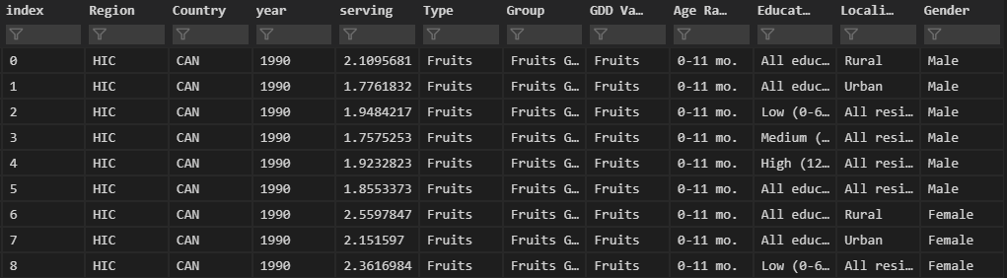
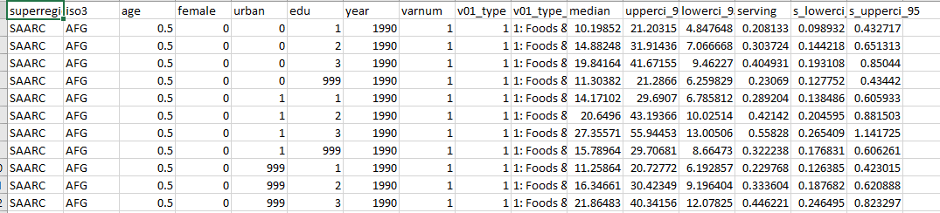
Data Preparation – Question 1

Slide 21
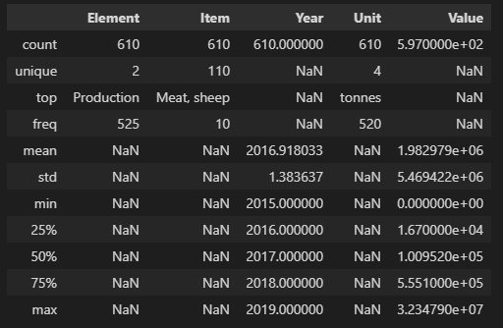
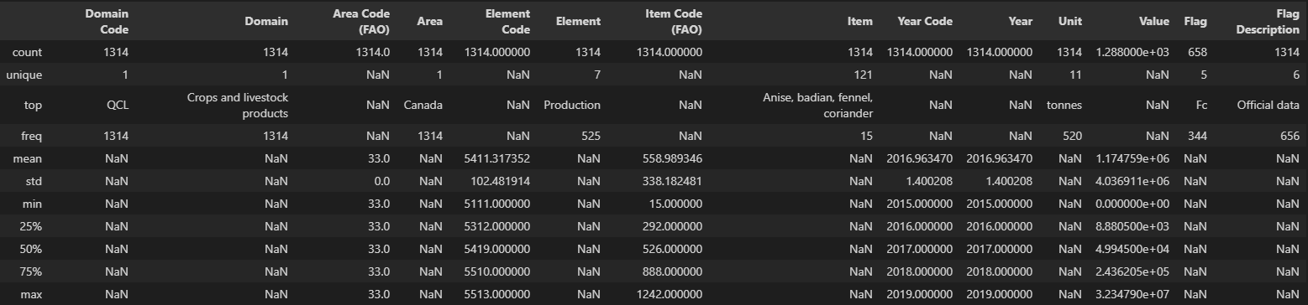
Data Preparation

Slide 22
Visualization – Dashboard
Notes:
Provide a screen shot of the visualization built in Power BI or Tableau.

Slide 23
What is the Canadian diet, and does it meet the guideline of health and balance? How much of Canada’s population can be fed on food grown nationally?
Canadians meet diet guidelines but much of Canada's population is on the lower middle limits of a balanced diet. Neither location nor level of education play major roles in the Canadian diet, and throughout the country, as Canadians get older, their diet balances out and remains steady through their adult lives.
Diet needs can be met in Canada through food produced locally such as grains, meats and vegetables. Canadians need to trade internationally for fruits and to introduce variety into the diet.
Notes:
The answer to the question from Slide 21 needs to be supported by the data visualized in the previous steps.

Slide 24
Question 2
Who are our trade partners, how does trade affect us, what is our food availability and how secure is our food future?

Slide 25
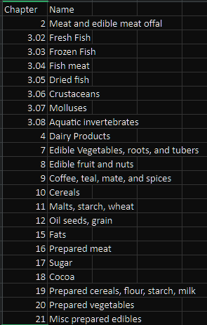
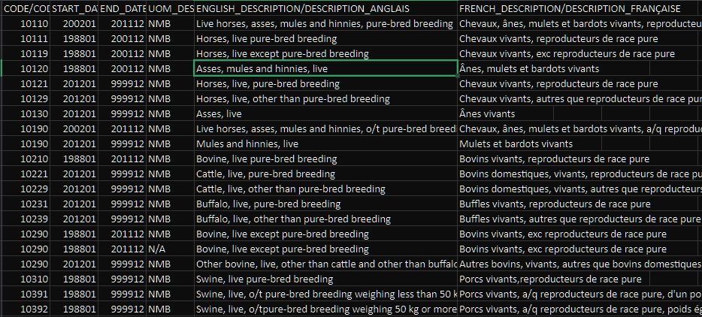
Data Preparation

Slide 26
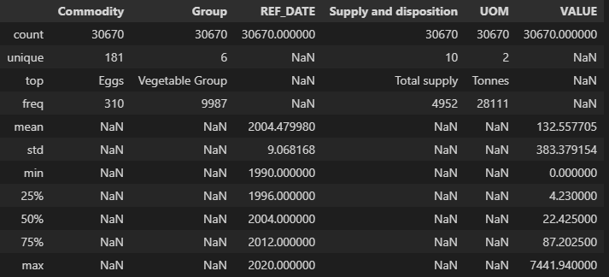
Data Preparation

Slide 27
Visualization – Dashboard
Notes:
Provide a screen shot of the visualization built in Power BI or Tableau.

Slide 28
Who are our trade partners, how does trade affect us, what is our food availability and how secure is our food future?
Food trade continues to spread throughout the world and Canada imports 2.5x as many unique items than we produce and export.
Canada trades with many of the food producing exporters of the world. This leads to a great outlook on Canada's food security because the data extrapolated to the future shows a steady and slow increase in diet needs and national food production, as expressed by the low feature importance of date given to the Canadian diet model.
Almost 10% of the available food is lost and much more is wasted. Every year Canada produces all the food necessary for a balanced diet and much of it wasted, creating room for efficiencies and improved management of food.
Notes:
The answer to the question from Slide 21 needs to be supported by the data visualized in the previous steps.

Slide 29
Question 3
What food is wasted the most and what can be done to reduce the impact on Canadians?

Slide 30
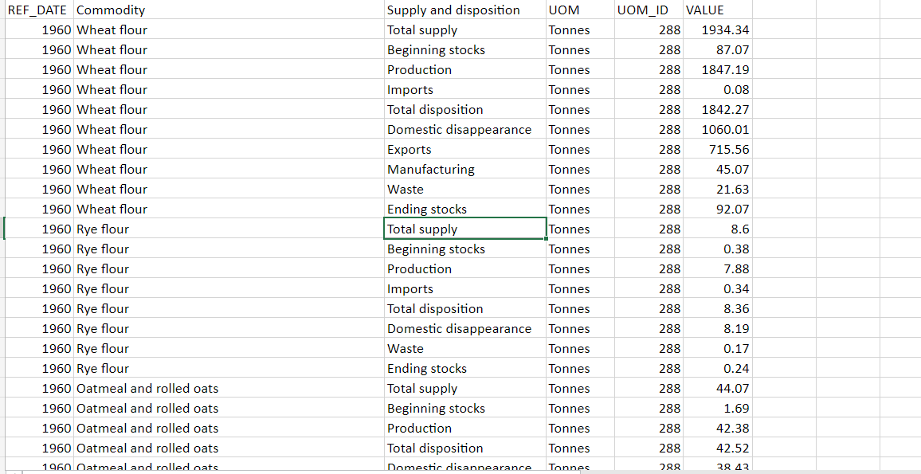
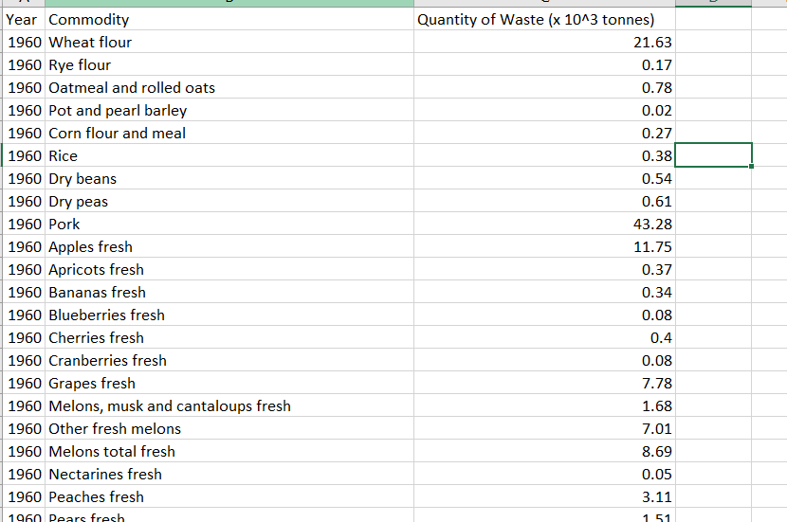
Data Preparation
Notes:
Provide a screen shot of the visualization built in Power BI or Tableau.

Slide 31
Visualization – Dashboard
Notes:
Provide a screen shot of the visualization built in Power BI or Tableau.

Slide 32
What food is wasted the most and what can be done to reduce the impact on Canadians?
In Canada, potatoes are wasted far more than any other food, followed by pork, tomatoes, melons, and wheat flour.
Potatoes constitute the overwhelming amount of food waste in Canada, therefore any efforts to reduce our waste consumption should focus mostly on potatoes. One way to reduce potato waste would be to design better storage systems that keep potatoes good and fresh for longer periods of time. This would ensure that people and businesses save more money by getting more use out of each purchased potato.
Lettuce is the only major food to have trended towards less waste in Canada. More efforts should be made to study why that is and if there are any lessons to be learned.
Notes:
The answer to the question from Slide 21 needs to be supported by the data visualized in the previous steps.

Slide 33
Question 4
Which sectors of Canada’s food industry have the highest profits? Which sectors need improvement? How would these sectors improve their performance?

Slide 34
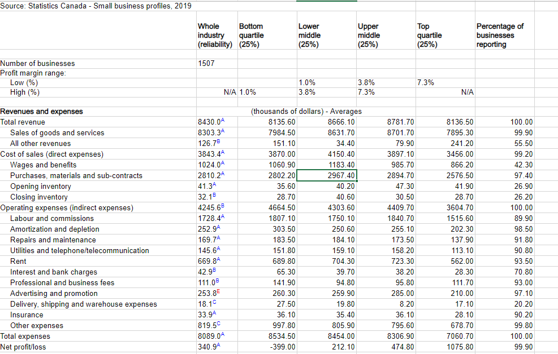
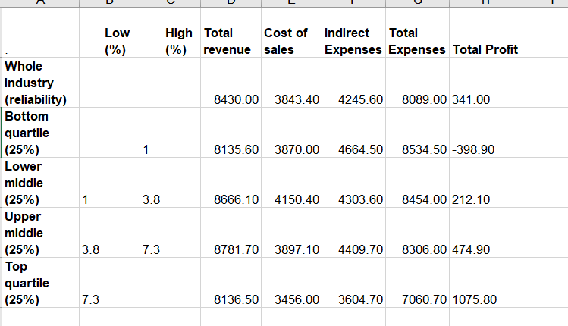
Data Preparation

Slide 35
Visualization – Dashboard
Notes:
Provide a screen shot of the visualization built in Power BI or Tableau.

Slide 36
Which sectors of Canada’s food industry have the highest profits? Which sectors need improvement? How would these sectors improve their performance?
Out of all of Canada's food sectors, agriculture makes more profits than animal production and food services combined with approximately $2,346,900 in profits in 2019.
Canada's big business food sectors generate big profits. However, in 2019 Canada's small business food sectors either lost money or were just above the profit margin. Canada's small business food sectors need improvement.
Profit margin data across the performance distribution for all of Canada's food sectors shows that successful food businesses in Canada succeed because they can effectively reduce costs rather than earning the highest revenues. Better management would help improve Canada's struggling food sectors.
Notes:
The answer to the question from Slide 21 needs to be supported by the data visualized in the previous steps.

Slide 37
Question 5
What was the effect of COVID-19 on Canada’s restaurant industry? What was its effect on personal cooking? Which should Canadians invest more resources in?

Slide 38
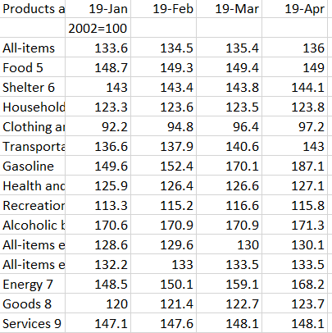

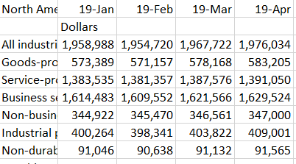

Data Preparation

Slide 39
Visualization – Dashboard
Notes:
Provide a screen shot of the visualization built in Power BI or Tableau.

Slide 40
What was the effect of COVID-19 on Canada’s restaurant industry? What was its effect on personal cooking? Which should Canada invest more resources in?
With so many available locations in Canada and a plethora of grants available, starting a restaurant is an easier and more affordable task. Finally, there are a lot of places you can rent that are vacant, making it easier to start up a restaurant.
COVID caused a loss in income for restaurants because people could not enter, however, more people started cooking at home, saving money by not going out to eat and by learning how to cook. Now that restaurants are gradually opening to let more people eat in, they are returning to profitability. Data suggests that Covid considerations cannot be considered when deciding whether to start a business.
Notes:
The answer to the question from Slide 21 needs to be supported by the data visualized in the previous steps.

Slide 41
Question 6
Which sectors of the food industry are seeing accelerated innovation? Which areas are lacking and what can be done to increase efficiency or innovation?

Slide 42
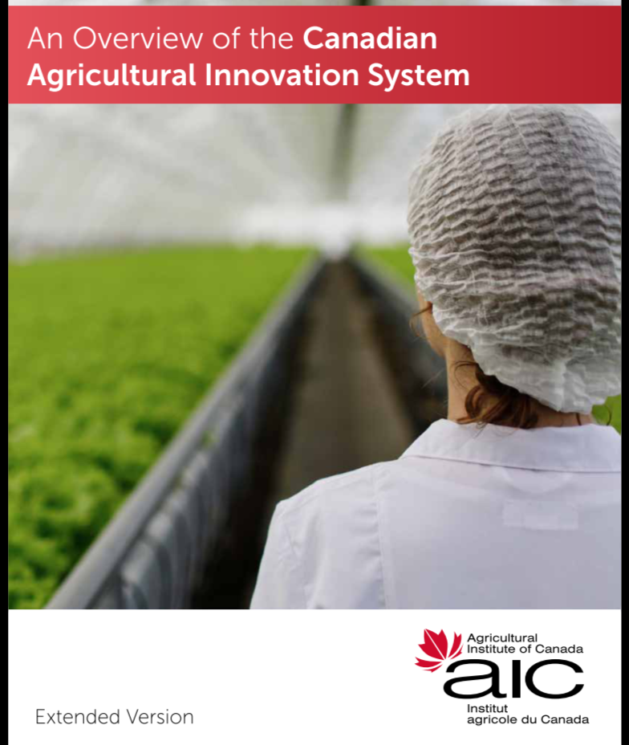
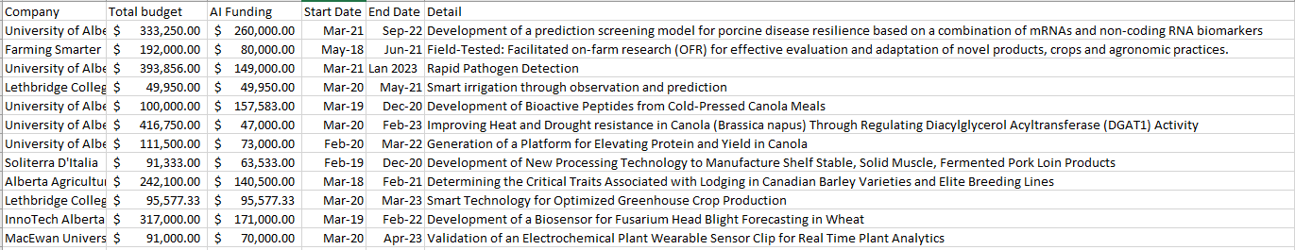
Data Preparation
Notes:
Provide a screen shot of the visualization built in Power BI or Tableau.

Slide 43
Visualization – Dashboard
Notes:
Provide a screen shot of the visualization built in Power BI or Tableau.

Slide 44
Which sectors of the food industry are seeing accelerated innovation? Which areas are lacking and what can be done to increase efficiency or innovation?
The data shows funding for technology and research on improving farm conditions to reduce diseases and research on climate resistant farming.
The average budget for innovative research is $517,763.94 with the average AI funding equaling $179,704.09. The largest budget was for an application for armchair ranching at $4,847,000.00 with an AI Fund of $481,000.00. The program with the largest AI budget is an application that creates a food safety plan for agri-food businesses with AI funding of $500,000.00
The industry problems highlighted in our previous solutions show that more innovation is needed that increase management efficiency and reduce waste. Our analysis shows that Canadians naturally eat a balanced diet, so creative solutions that send heathy food direct to customer is an area that needs to be explored further.
Another potential investment opportunity comes from the fact that Canadians are multi-cultural and enjoy going to restaurants as evidenced by the GDP and CPI graphs. Applications that build on this multi-cultural community will be able to reach potential customers across Canada.
Notes:
The answer to the question from Slide 21 needs to be supported by the data visualized in the previous steps.

Slide 45

Thank You!
Questions?

